Slide 1
L-Titrator Reservoir 센서 적용 컨셉
Creativity & Confidence
www.atikorea.com

Slide 2
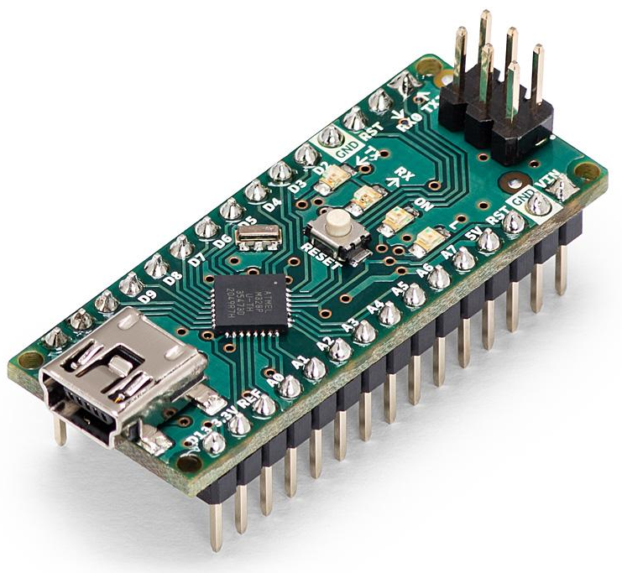
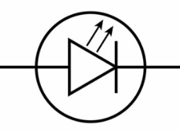
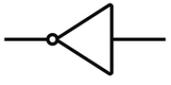
2. Test 항목 - 1) calibration - HF
Concept
Reservoir + Sensor → ①Sub Module(자체 제작) → L-Titrator Main Board
Reservoir + Sensor →②Sub Module(Arduino Nano + Ext Board) → L-Titrator Main Board
①
Sub Module
②
Sub Module
Step down
(24V → 5V)
MCU
STM32G031
(20-TSSOP)
LDO
(5V → 3.3V)
Arduino Nano
3.3V
GPIO
74LVC540
(8ch)
4.7K
LED
(3-Port)
SENS IN
(8-Port)
3.3V
X 3
Interface
UART#1
UART#2
+
RS232
(DEBUG)
RS485
(Main board)
Extension Board
(Connector + RS485)
Spare
ADC
I2C

